Slide 1

Survival of the Fittest
Kevin Black, Catherine Hwang, Davis Knowles,
Stephanie Nickerson & Jourdan Norman
Notes:
Stephanie – Team Name, Team Members, Project Name & turn over to Kevin

Slide 2




HR: Survival of the Fittest Data Scientist
Overview
Data Source: Kaggle’s HR Analytics and Job Change of Data Scientist data
Selection Criteria: Relevancy to the class
Analytical Purpose: Determine common characteristics of individuals that move from training into Data Scientist jobs
Data Cleansing: Preparation of data for evaluation and analysis
Notes:
Kevin – Data Source: (https://www.kaggle.com/arashnic/hr-analytics-job-change-of-data-scientists)
Why did we select it: Using HR Analytics and Job Change of Data Scientist data, to determine the common characteristics of individuals that move from training into Data Scientist job
What do we hope to solve: Determine common characteristics of individuals that move from training into Data Scientist jobs. What is the correlation between years of experience, training completion and movement into a new job? What is the correlation between education level and those looking for jobs? Is there a gap between training hours completed based on gender? Predict the probability that a candidate will work for the company based on
Data Cleansing: We sourced three files which we merged together and removed duplicate and incomplete data.

Slide 3
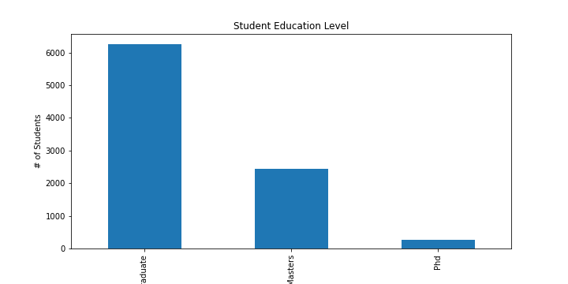
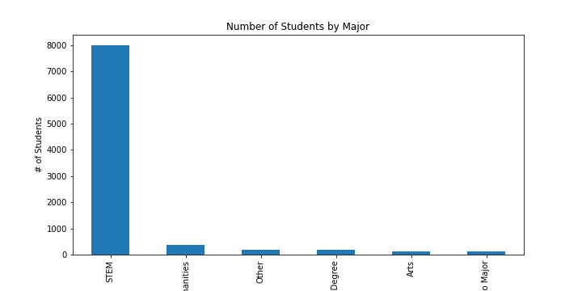


General Data Characteristics
Notes:
Catherine: As Kevin mentioned during his overview, we cleansed our data which left us with a population size 8955. When we performed a general evaluation of the data we found, 90% of the students were male, over 6k have graduate level degrees and most have STEM majors.

Slide 4
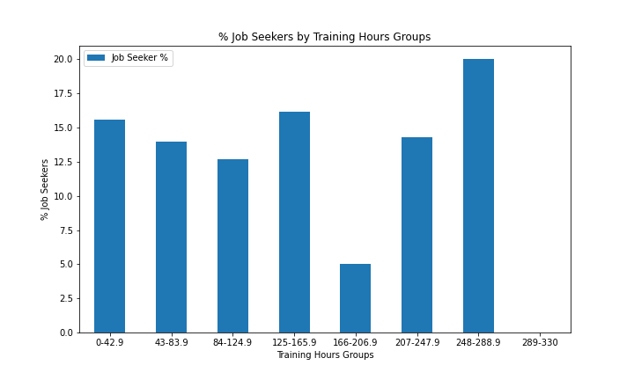
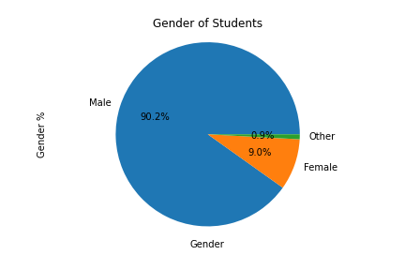


General Data Characteristics
Notes:
Catherine continued: 35% of the student train between 207 and 289 hours, quite similar to the number of training hours we will complete. We need to get more details on the job seekers by training hours slide. I’m not sure what the numbers are so I can’t interpret it. Turn it over to Davis

Slide 5
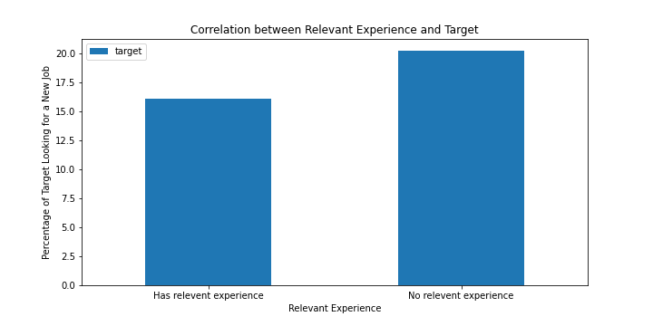
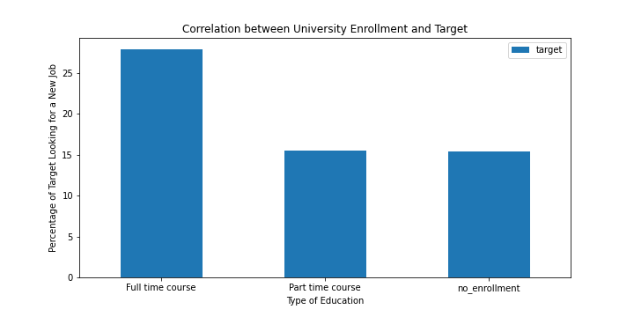


Experience and University Enrollment
Notes:
Davis: Thanks Catherine. Now let’s talk a little about what we found when we analyzed the data. Explain the two graphs (I have no clue). Then send to Jordan

Slide 6
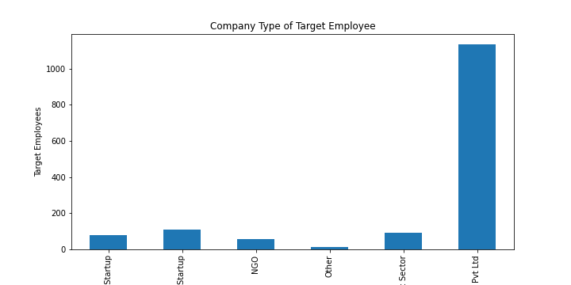
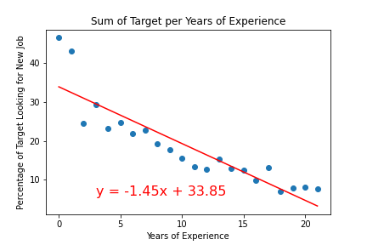


Experience and Company Type
Notes:
Jourdan: Now let’s wrap our analysis with our findings that are most important to you. We found that the more years of experience that a student has, the less likely they are to search for a job at a new company. For those that are looking for a job, they are more likely to seek employment with a private company. Add anything else.

Slide 7

This Photo by Unknown Author is licensed under CC BY-SA
Notes:
Stephanie: I’ll wrap us up and ask about questions. We should all be prepared to answer.

